Slide 1
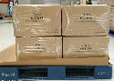
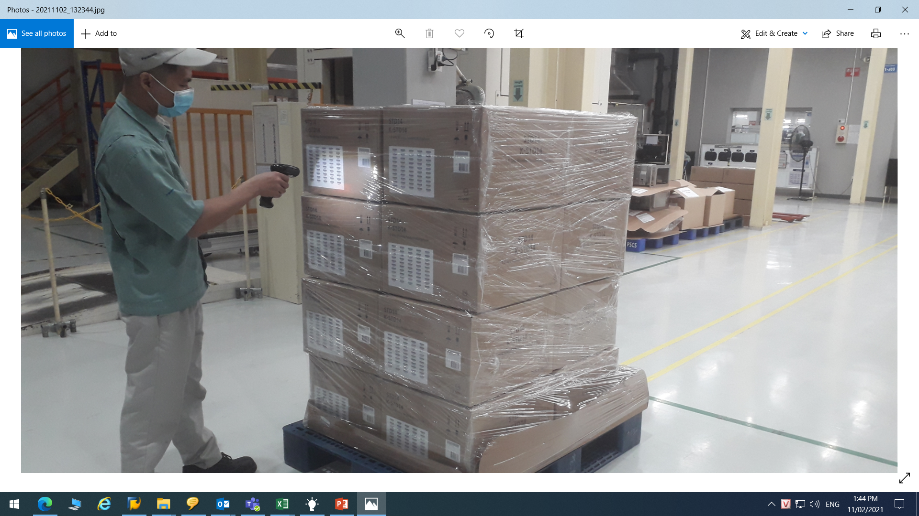
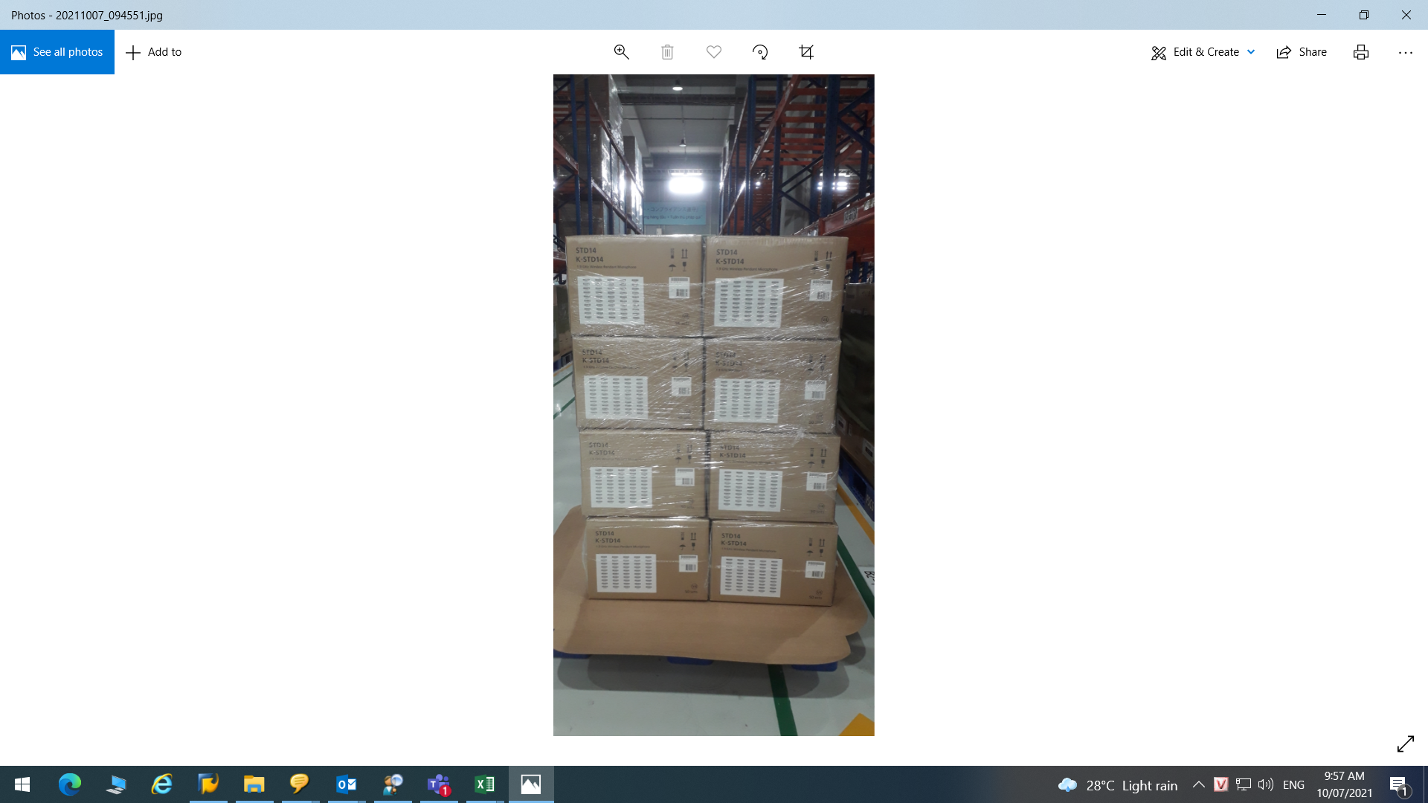
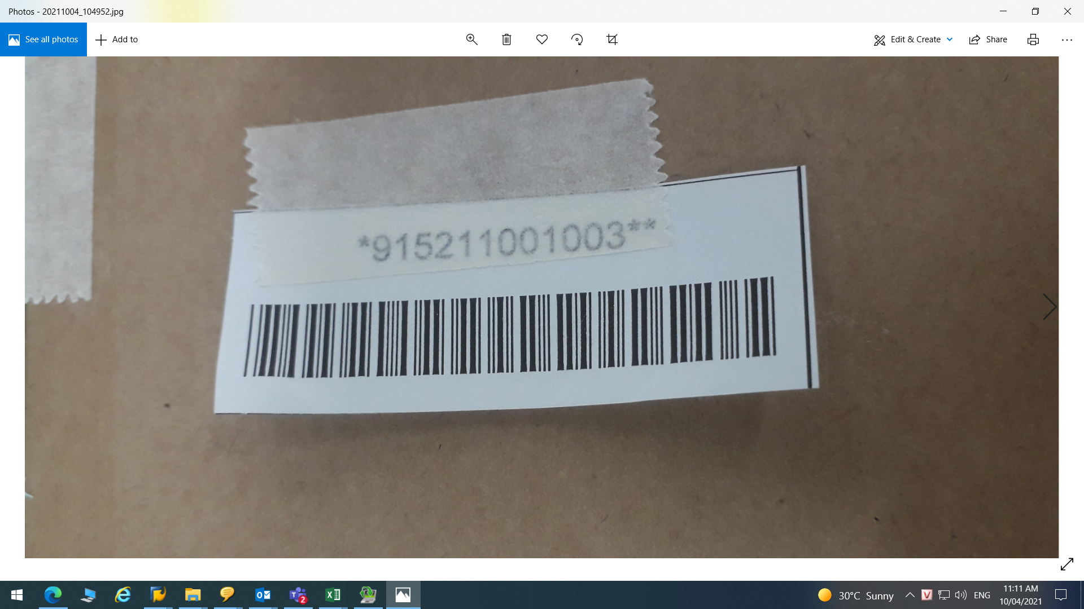
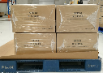
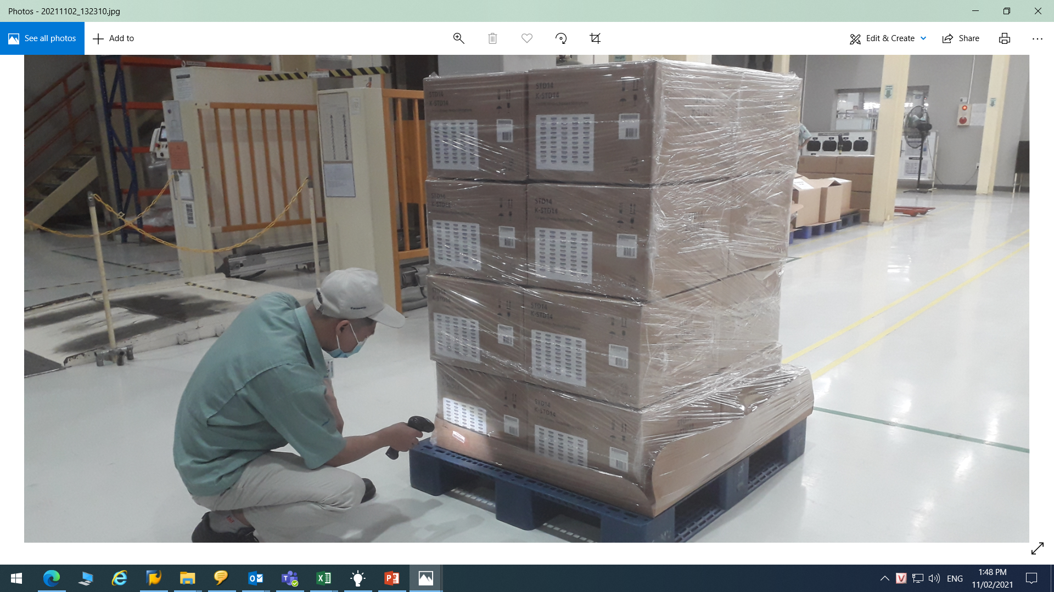
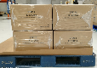
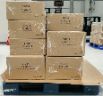
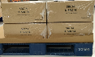
13/3
Develop new function at SCM WH to reduce operation time for Sound Biz
♦ Before
♦ After
SCS: prepare cargo for shipment
SCS: prepare cargo for shipment
K-STD14 – V4.
K-STD14 – V4.
K-STD14 – V4.
K-STD14 – V4.
Separate Qty
Separate Qty
Emty pallet ID
Reading seri one by one
K-STD14 – V4.
K-STD14 – V4.
K-STD14 – V4
Reading seri one by one
K-STD14 – V4
K-STD14 – V4
K-STD14 – V4
Mix model
K-SRC14 – V4
Mix model
K-SRC14 – V4
K-SRC14 – V4
K-SRC14 – V4
Only download all data & serial No with short time
Currently:
Prepare cargo for soundbiz shipment.
Not yet software to separate & compare cargo..
Not yet outer carton code.
Many seri/carton (40 pcs)
→ Reading 100% serial when separate or compare
Take time: 35 minutes/pallet
~ 17.5 hour/30 pallet/month ~ 210 hour/year
Improve :
Request IT to develop a new function on system to :
Issue emty pallet ID & can combine other model or same model
Separate some qty from full pallet & Add to emty pallet ID
SCM can save shipping data & down load history data from soft ware
Special: Issue Software new function for shipping ats SCM that separate with FA system & Do not affect to FA data when SCM operate.
Take time: 20 minutes/pallet ~ 10 hour/month ~ 120 hours/year.
Save: 210 hour – 120 hour = 90 hour/year ~ 300USD

